Slide 1
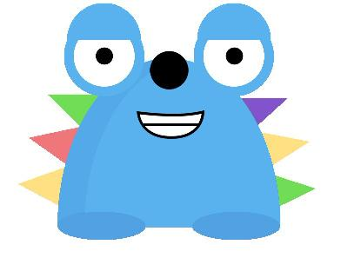
Resource Pack for Primary Schools

Slide 2
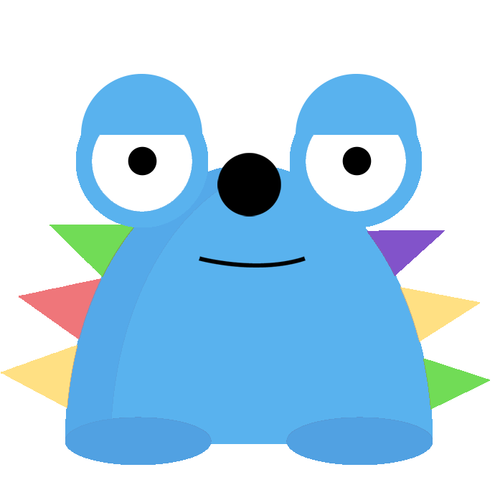
Welcome to the Play Observatory
The Play Observatory is a project researching children and young people’s play and activities during Covid-19 and beyond.
We want to understand children's play and leisure experiences during this unique time in history and inform future generations' understandings of young people's lives.
Our online accessible survey is now live, collecting examples of play over the past year. We are also collecting examples by post.
Children and their parents/legal guardians can sign up to tell us about their play, as can organisations such as early years settings, schools and youth groups.

Slide 3
Who is involved?
The study is funded by the Economic and Social Research Council
The Play Observatory team brings together researchers from the School of Education at the University of Sheffield, UCL Institute of Education, and The Bartlett Centre for Advanced Spatial Analysis at UCL.
Our project partners are the British Library, the V&A Museum of Childhood and Great Ormond Street Hospital
There is one more member of the team to meet…

Slide 4
Meet Peeps
Peeps is a member of our team who helps to explain our project for younger children
You can meet Peeps by following this link.

Slide 5
Songs and rhymes
Beliefs, superstitions and rumours
Customs and celebrations
Online play with games, video clips, memes and apps
Imaginative play and play with toys inside and out of doors
Play with friends, family and pets
Crafts, creating, making and baking
Jokes, poems and stories
What are we collecting?

Slide 6
What are we collecting?
Contributions can take the form of…
Descriptions of play and activities
Photographs
Images of drawings or things you have made
Screenshots of online games you are playing
Video clips
Audio recordings
Links to media clips such as YouTube and TikTok
You can upload up to 6 files at a time. You can also come back at a later time and submit more examples to the collection.

Slide 7
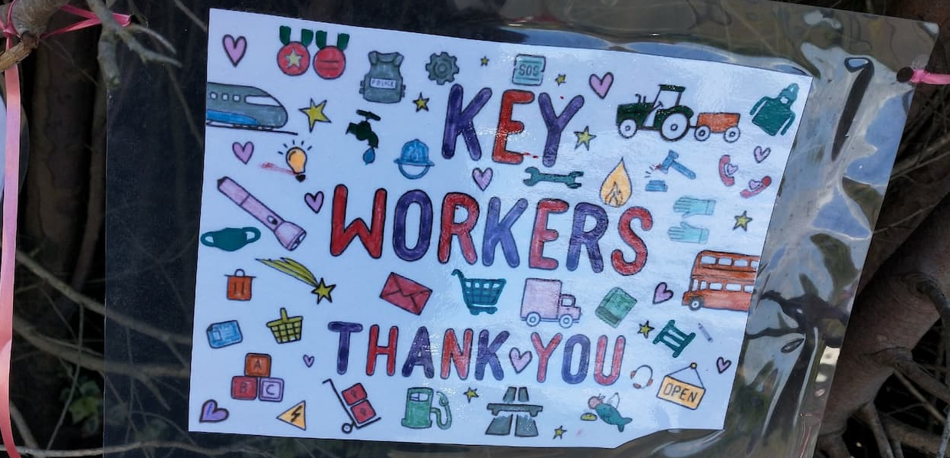
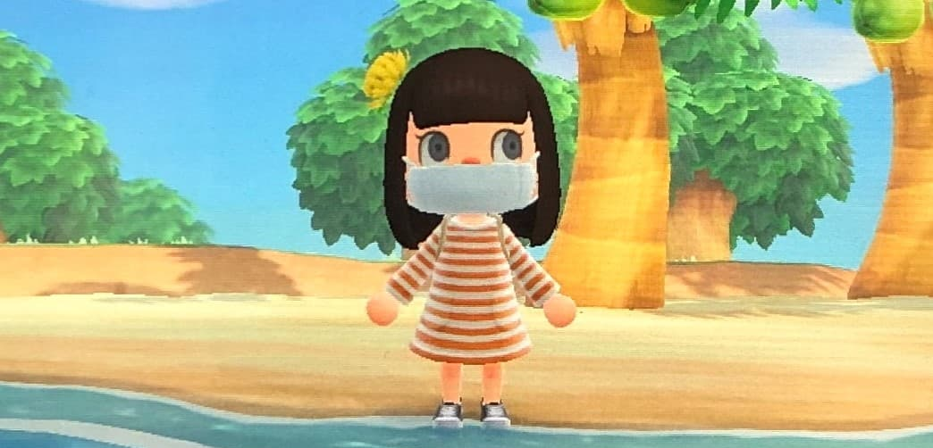
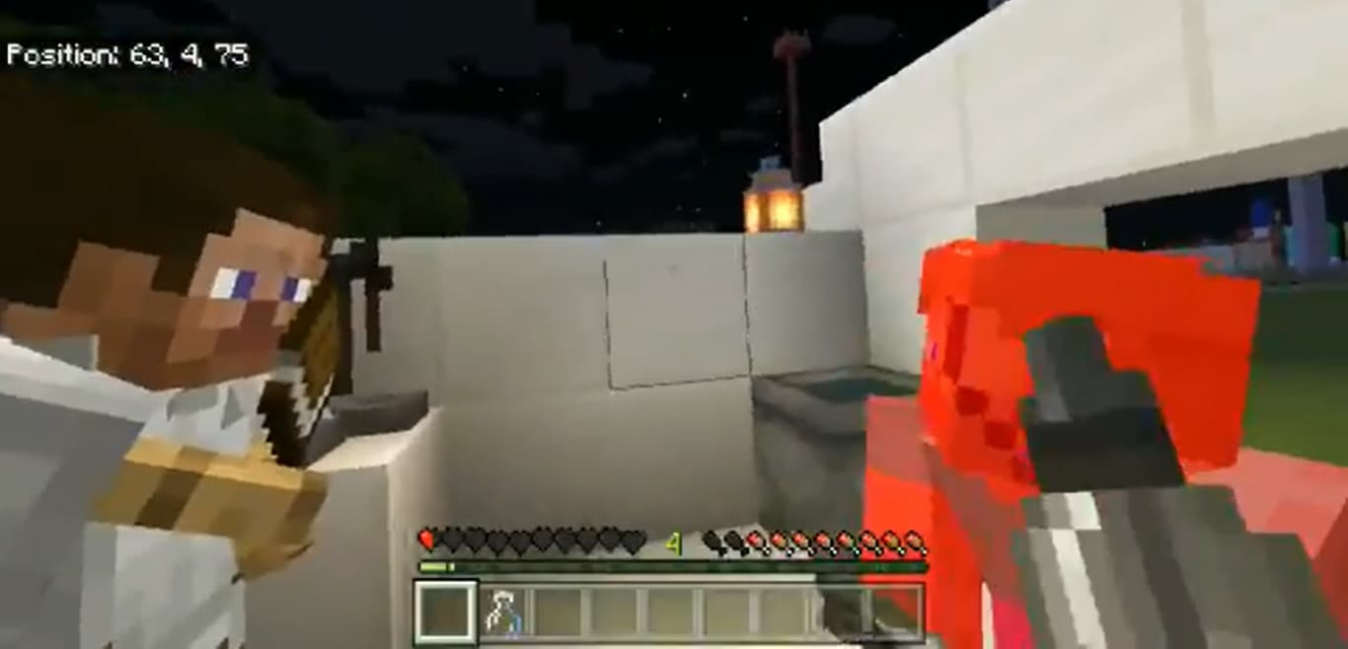

Slide 8
Play Observatory contributions will be preserved for history
Contributions to the Play Observatory collection will become part of a national archive about children’s play and leisure experiences during the pandemic at the University of Sheffield and at University College London.
A sample from the collection will be archived by the British Library and some examples will feature in an online exhibition at the V&A Museum of Childhood in 2021/22
Contributions will inform researchers about children’s play and wellbeing, helping us create a resource for parents, careers and professionals, co-produced with Great Ormond Street Hospital

Slide 9
Getting started
Before you get started, please head to our website to find out more about the project and see some of the types of contributions we are getting: https://play-observatory.com/
Then you can read the ‘Play your part’ section, which will give the information you need to know before you go to our survey page and register with the Play Observatory. Here’s a link to the page: https://www.play-observatory.com/play-your-part/section-one
Peeps features in the Play your part section to provide clear information aimed at explaining the survey to younger children

Slide 10
Gaining parental consent
To submit images of or contributions from children in your school or organisation it’s important that we have the consent of parents / caregivers and children.
Included in this pack is a PDF copy of a consent form which you can print and send or email to parents, and return to us online or by post. Or you could send us a photograph of the completed form. This can be taken on a phone or other device.
Please invite parents and caregivers to visit our website so they know about the project and what they are signing up for. Or you can share a copy of the flyer included in the resource pack.

Slide 11
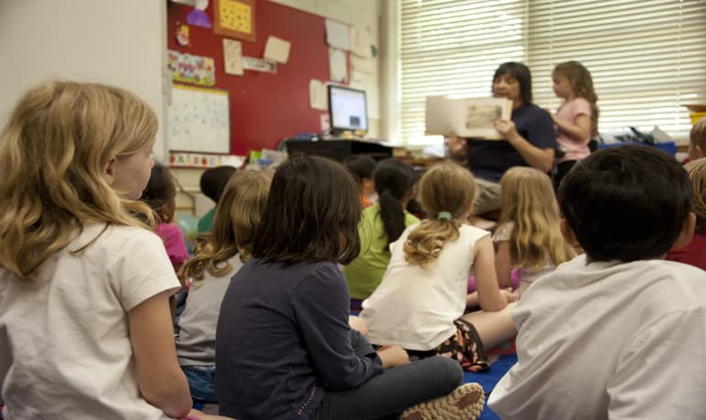
How primary schools can take part

Slide 12
How primary schools can take part
If you are a primary school, staff can sign up to contribute on behalf of the setting.
You can upload your thoughts about the play that you have seen children engaging in – in writing or by uploading photos, audio recordings or video recordings. There is advice on the Play Observatory website about the kinds of images and recordings we can and cannot accept: https://www.play-observatory.com/play-your-part/section-five
You can also engage in Play Observatory activities with the children who attend your school to help collect children’s ideas about their play in their own words
See some of the following slides for ideas

Slide 13
Possible activities and starting points
The following slides outline some possible ideas based on the following themes:
Map your play places (primary and early years aged children)
Games, jokes, words, songs and rhymes about the pandemic
Things you have made during the pandemic
Rumours, sayings and superstitions
Seeing people, visiting and going on trips
Being alone and with others
Life events and special occasions
Diary Task
These ideas are starting points, and you can do just one activity or lots of them.

Slide 14
My mates called the virus ‘the rona’
I learned a clapping game about coronavirus – we played it at school
We had an online scavenger hunt around the house with my Cubs Group!
My youth club played games online and shared our favourite YouTube videos when we couldn’t meet
I remember my birthday party on Zoom – it was so good seeing my family again
I made socially-distanced snowmen with my Dad
I mixed up potions and imagined I was a scientist making a vaccine
We found a new hang out in the park
Our neighbourhood made a Teddy Bear Trail

Slide 15
1. Map your play places (early years and primary age children)
Can you draw a map to show us the places you have been playing and what you played there?
Your map can be a map of your house, your school playground, important places in your local area or even places you’ve built online in games
Your map can be as big or small as you like. You can use pencils, crayons, paints, draw it online or even make a 3-D map with materials
Once you’ve finished it take a photo or make a video showing it so it can be uploaded to the Play Observatory survey

Slide 16
2. Games, jokes, words and rhymes and the pandemic
Do you know any jokes, raps or rhymes to do with coronavirus and the pandemic. They could be about lockdown, facemasks, hand washing or social bubbles.
Have you heard any alternative names for the virus?
Have you been playing any games about COVID?
Tell us about them. You can:
Write them down – you can include pictures if you like
Have a conversation with your friends and record it
If you are sharing a game please tell us the rules!

Slide 17
3. Things you have made during the pandemic
Have you had more time to make things during the pandemic?
Maybe you’ve done drawings on paper, or on chalk on the pavement?
Maybe you’ve learned how to bake, or sew?
Maybe you’ve discovered new apps or digital equipment and have shared what you’ve made with your friends?
Tell us about what you’ve made, who you’ve made things with. If you can write about it, record yourself talking about it, and if you have a photo or video of it please sign up to the Play Observatory and upload it for us

Slide 18
4. Rumours, sayings, beliefs and superstitions!
Have you heard any rumours or urban myths, sayings or beliefs / superstitions about COVID-19?
What things have you heard that people do to avoid the virus?
Have you experimented with, or imagined making potions, spells or cures?
How can you look after yourself and others to avoid getting ill?

Slide 19
5. Seeing people, visiting and going on trips
How have you kept in touch with family and friends during the pandemic? Have you changed the ways you keep in touch?
Have you used any technology and what did you do with it?
Have you visited people, have they visited you, have you met up with people outside on day trips? What do you do and how did you play? What could you not do on these visits because of COVID-19 restrictions?
Have you been on holiday? Was it the same as going on holiday before or was some of it different? What activities were you able to do there?

Slide 20
6. Being alone and with others
Have you had more time to play by yourself during the pandemic? What was that like? What have you done to pass the time?
Have you had more time to spend with some of your family, maybe parents and siblings and people who live with you? Have you passed the time together, have you made things together? If so, tell us about it.
Have you used apps and social media to stay connected with family and friends? What have you done online together?
Have you made or shared things together like TikToks, YouTube videos, recordings and digital spaces? If so, tell us about it.

Slide 21
7. Life events and special occasions
How have you marked a birthday or other occasions in your life over the past year?
How has your family, group or community marked any special festivals during the past year?
Have you marked any important achievements in your family, friends or in your community, school or youth group?
Can you describe how you managed to get together – in real life or online - and what you did? You could share photographs, or draw pictures of what you wore, what you ate, where you got together.
How did the occasion make you feel? What differences did you notice compared with past events?

Slide 22
8. Suggested diary task
One way we learn about what it was like to live in difficult times is through diary entries written by people experiencing them first hand.
Children’s diaries have given us a child’s eye view of unusual and hard times in history – in future people will wonder what it was like for children during the global COVID-19 pandemic.
Children and young people could be asked to write a diary entry recalling one day during the past year that they remember e.g. the first day of lockdown, or a special event, or an experience they recall vividly.
They could create their diary entry through writing, drawing or illustrating, writing a blog, making an audio recording or a video.
Perhaps your whole group could choose a day and make a shared diary entry?
Please share with the Play Observatory!

Slide 23
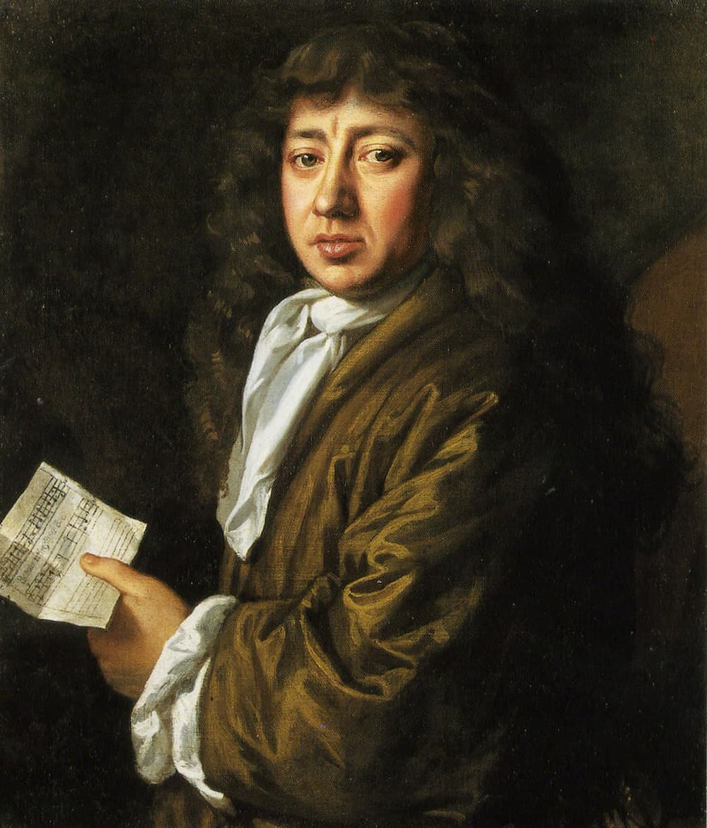
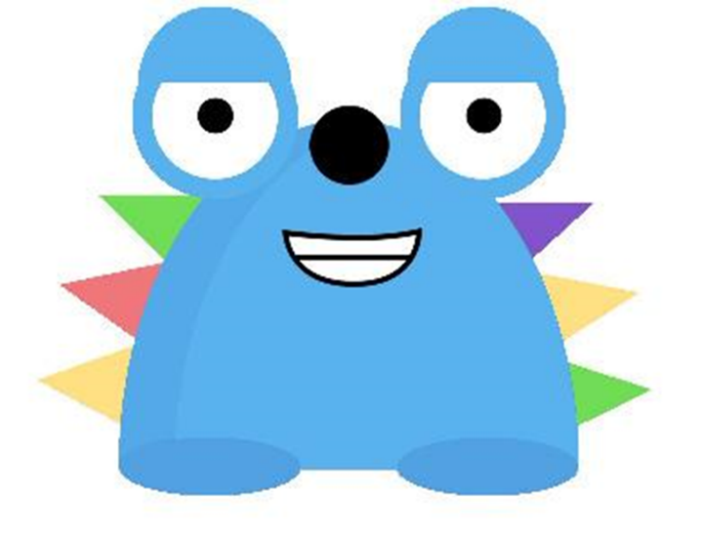
Peeps here! Did you know I share my name with someone who kept a diary during difficult times?
His name was Samuel Pepys, and he recorded events during the Great Plague, and the Great Fire of London in 1665 - 1666
We even pronounce our names the same way! He wasn’t a shape-shifting time traveller like me though…
Can you think of anyone else who kept a diary during a notable time in history?

Slide 24
Suggested Diary Task
A Day in the Life of a Naturalist in Lockdown:
Dara McAnulty is a teenage naturalist and writer from Northern Ireland. His first book Diary of a Young Naturalist has won awards for nature writing.
Dara has spoken about how his autism means he feels comfortable in outdoor spaces and has played a part in his appreciation of nature in a positive way.
During lockdown Dara shared a diary of his day. You can read it here:
https://www.southbankcentre.co.uk/blog/articles/dara-mcanulty-day-life-naturalist-lockdown

Slide 25
Want some help or guidance?
If you have any questions or just want to let us know what you’re planning please get in touch via email at: info@play-observatory.com
Contact us by post at:
The Play Observatory
School of Education
The University of Sheffield
241 Glossop Road
Sheffield
S10 2GW

